Slide 1






Halloween’s Candy Ranking
22224546 Srichainan Jirawan
22229519 Chaiorawan Siriyaporn

Slide 2
Introduction
we will explore the Halloween candy rankings dataset from 2017
The analysis is divided into three key parts:
1. Proving Hypotheses: 3 hypotheses
2. Data Visualization: visual insights using various charts to illustrate trends and patterns
3. Statistical Evidence: use t-statistics and p-values to validate our findings and demonstrate statistical significance

Slide 3
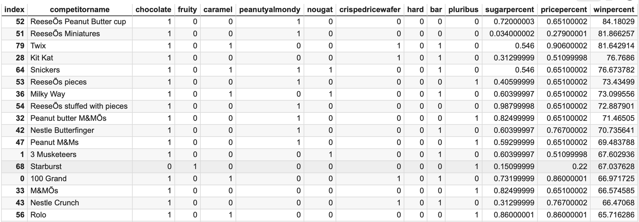
OUR DATA
1 = Yes (There a following ingredient in the candy)
0= no (There is no following ingredient in the candy)

Slide 4



Our hypothesis
Reese’s peanut buttercup is the most popular candy during halloween
chocolate is the most often used ingredient/feature in Halloween candy
chocolate and caramel is the combination of ingredient or feature with the highest correlation

Slide 5
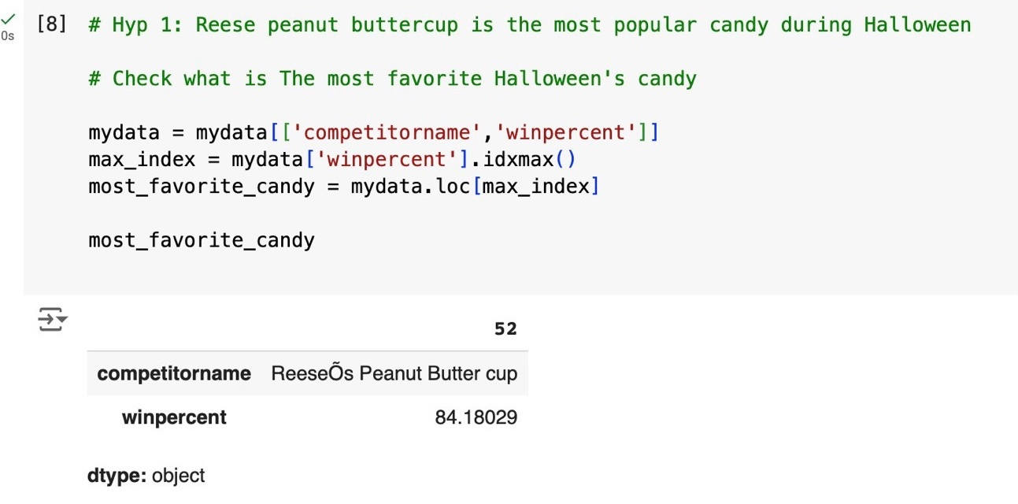
Hypothesis 1
Reese’s is the most popular candy during halloween
st
1 Step
We check which candy is the most popular by using idxmax function to prove our hypothesis
Noted: access a specific row (to retrieve the entire row corresponding to that index)
The table prove that our hypothesis is correct which win percentage is approximately 84%
Outcome

Slide 6
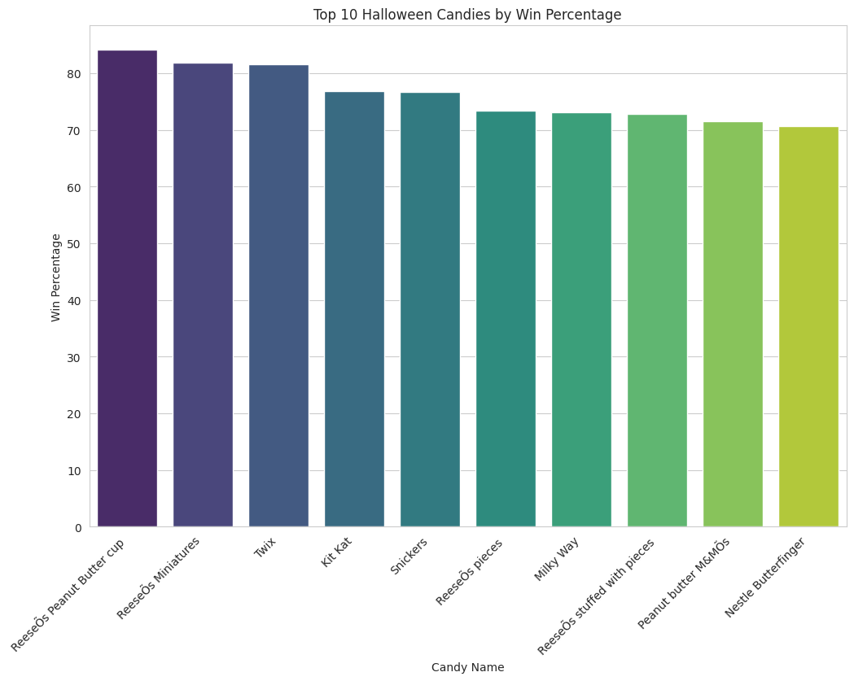
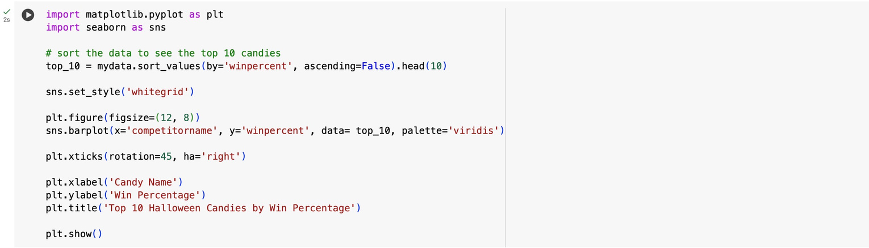
nd
Data Visualization
2 Step
Analysis
The bar chart shows that Reese peanut buttercup is the most popular candy during Halloween based on the win percentage, as it ranks first in the chart

Slide 7
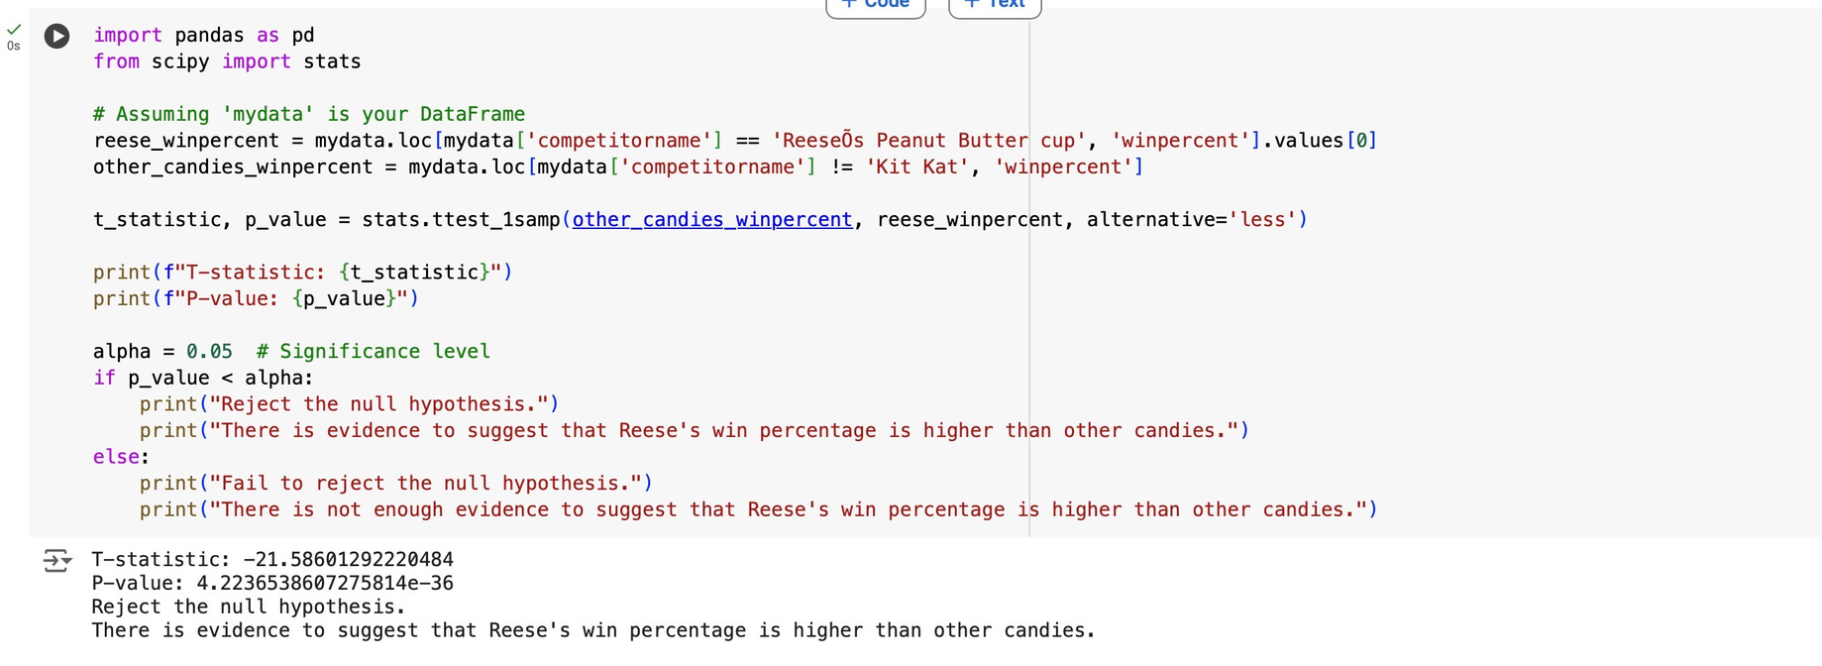

Hypothesis 1
rd
3 Step
Null Hypothesis : The win percentage of Reese's Peanut Butter Cup is not different from the win percentage of other Halloween candies.
Alternative hypothesis: Reese peanut buttercup is the most popular candy during Halloween
use loc function to extract only the win percentage of Reese’s Peanut Butter Cup from the DataFrame, Row(0)
use loc function to extract the win percentage of candies others than Reese’s Peanut Butter ( != -> not equal) Cup from the DataFrame

Slide 8

Hypothesis 1
Conduct T-stats /p-value
the focus is on the left tail of the curve, representing values that are significantly lower than Reese’s win percentage
one-tailed
-0.05
0
0.05
Reject H0
The output shows that it rejects the null hypothesis (P-value=4.22e-36 ) which means that the data show enough a strong correlation, concluding that Reese’s Peanut Butter Cup is statistically more popular than other Halloween candies.

Slide 9
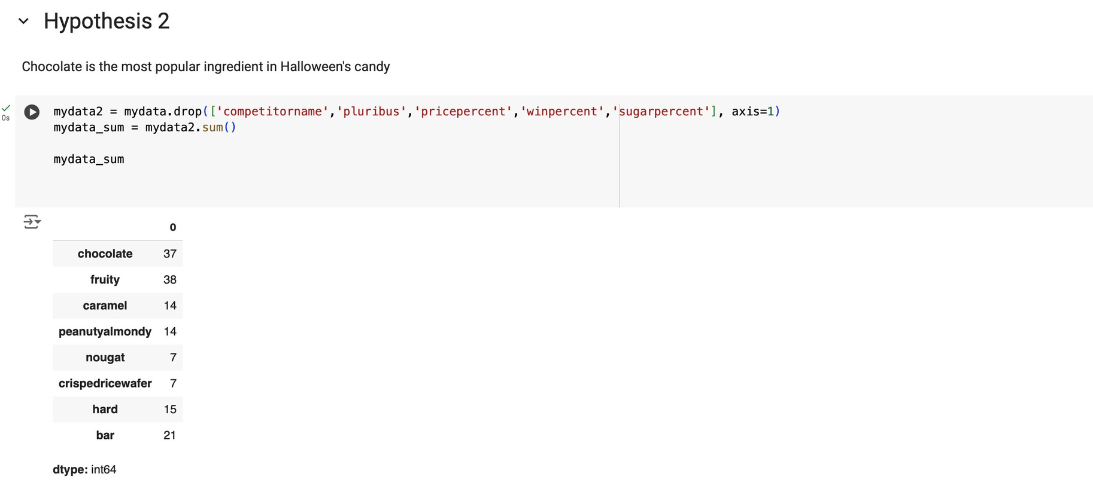
Hypothesis 2
chocolate is the most often used ingredient/feature in Halloween candy.
st
1 Step
We check if our hypothesis correct or not by using Sum function
Noted: Use drop function to remove an irrelevant column (axis=1)
The table shows that the most common ingredient found in Halloween candy was fruity, not chocolate

Slide 10
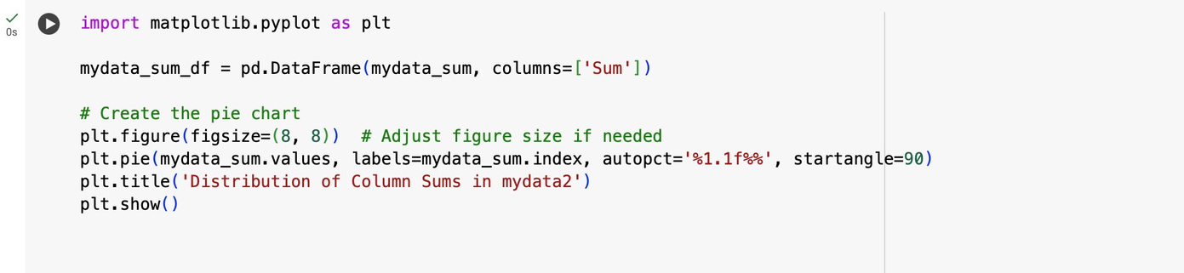
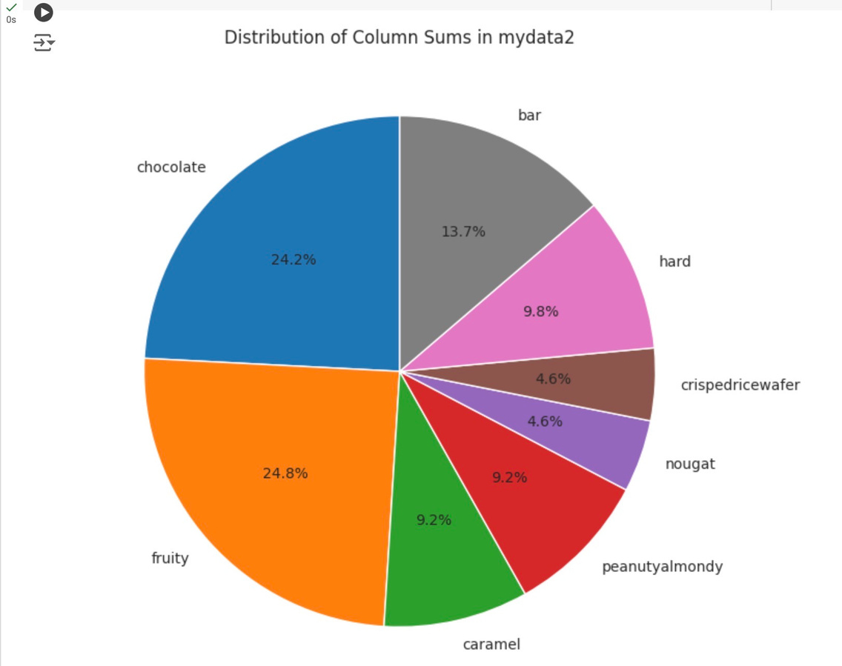
Hypothesis 2
nd
2 Step
Data Visualization
Analysis
From the pie chart above, it shows that the most popular attribute in Halloween's candy is not Chocolate (24.2%. Fruity has the highest percentage of popularity (24.8%), followed by chocolate in second place and bars in third place (13.7%).

Slide 11
Hypothesis 2
rd
3 Step
Null Hypothesis : The frequency of chocolate as a feature in Halloween candies is not different than the frequency of other ingredients
Alternative hypothesis: Chocolate is the most often used ingredient/feature in Halloween candy.
1 = Yes (There a following ingredient in the candy)
0= no (There is no following ingredient in the candy)

Slide 12
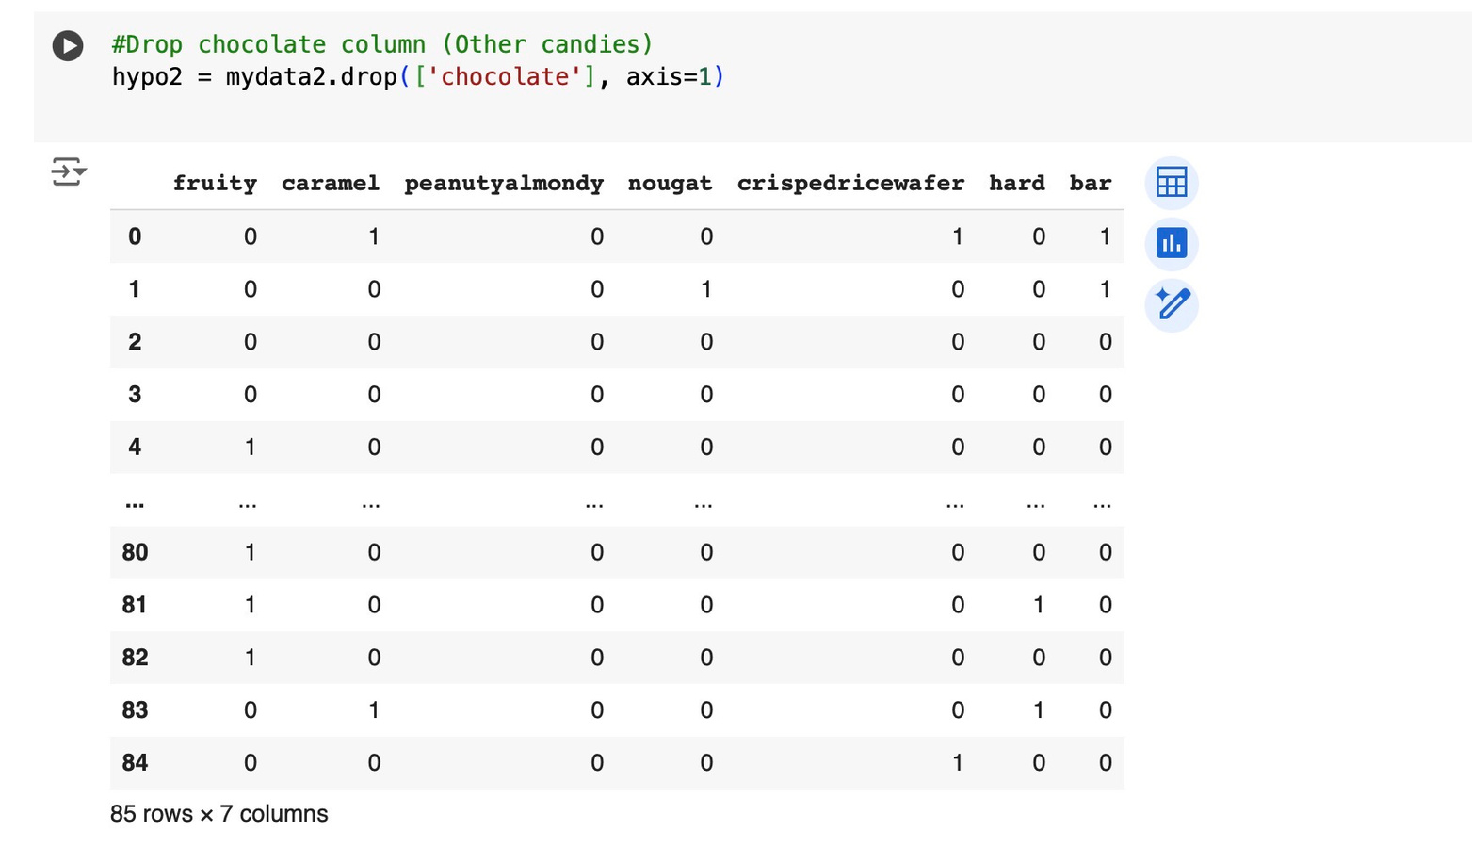
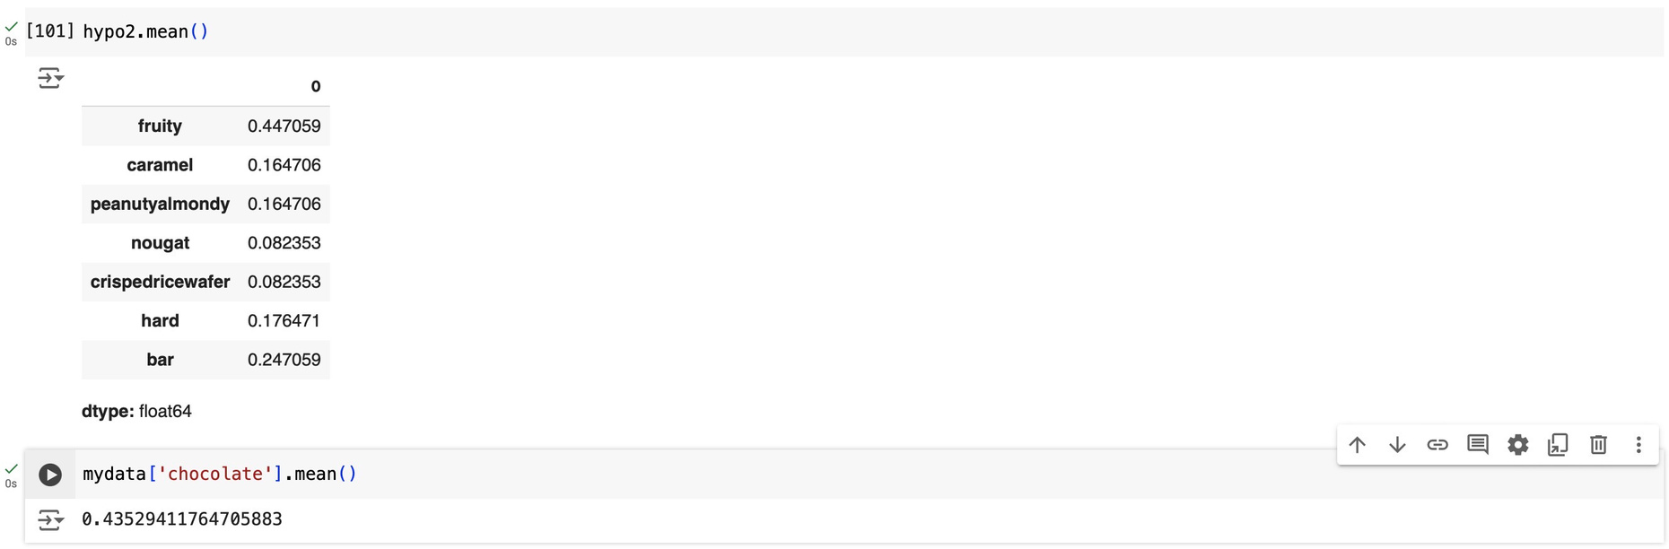
Hypothesis 2
create a dataset (hypo2) for candies that do not contain chocolate —> compare the presence of chocolate (chocolate candies) vs other attributes (non-chocolate candies) to be use in a t-test
Also, The mean provides a central tendency of the data - > to compare the average value of candies with chocolate against candies without chocolate

Slide 13
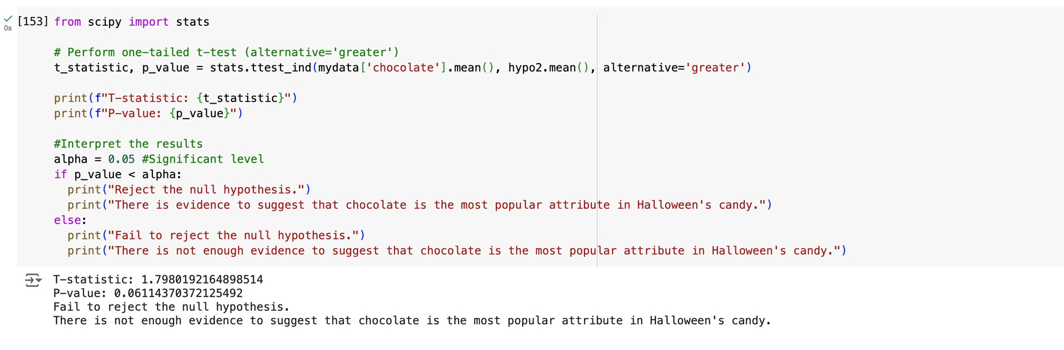
Hypothesis 2
One tailed
Fail to reject H0
-0.05
0
0.05
The output shows that it fails to reject the null hypothesis (P-value=0.06 ) which means that the data don’t show a strong enough correlation, indicating chocolate may not be the most influential factor in determining a candy’s popularity during Halloween.

Slide 14
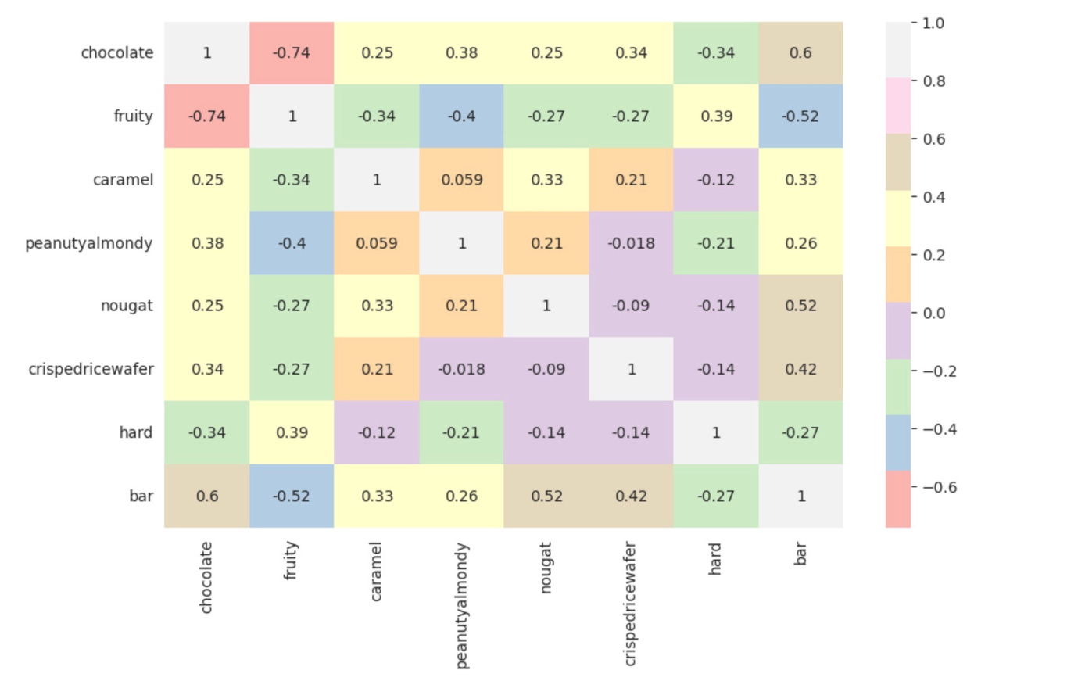
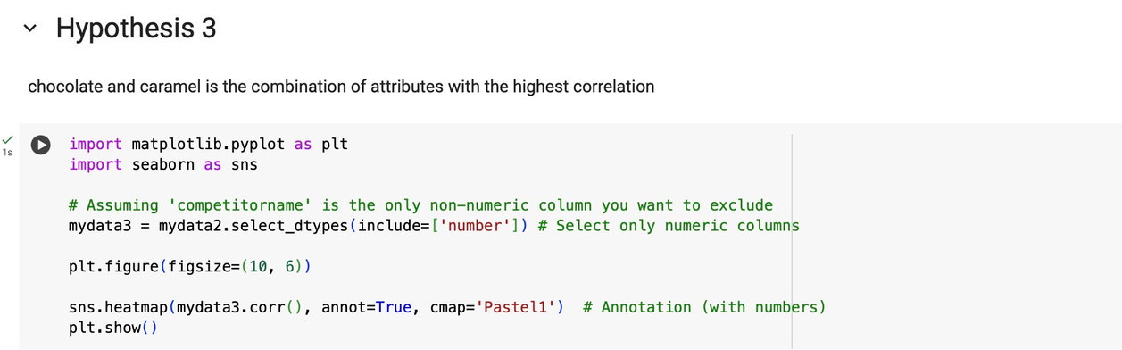
Hypothesis 3
chocolate and caramel is the combination of ingredient or feature with the highest correlation
nd
Analysis
From the heat map above, it shows the correlation between each variable. The combination of attribute with the most correlation is not chocolate and caremel (0.25), but chocolate and bar (0.6) because the correlation coefficient is closer to 1, which means there is a strong positive correlation between the chocolate and bar
1&2 Step

Slide 15

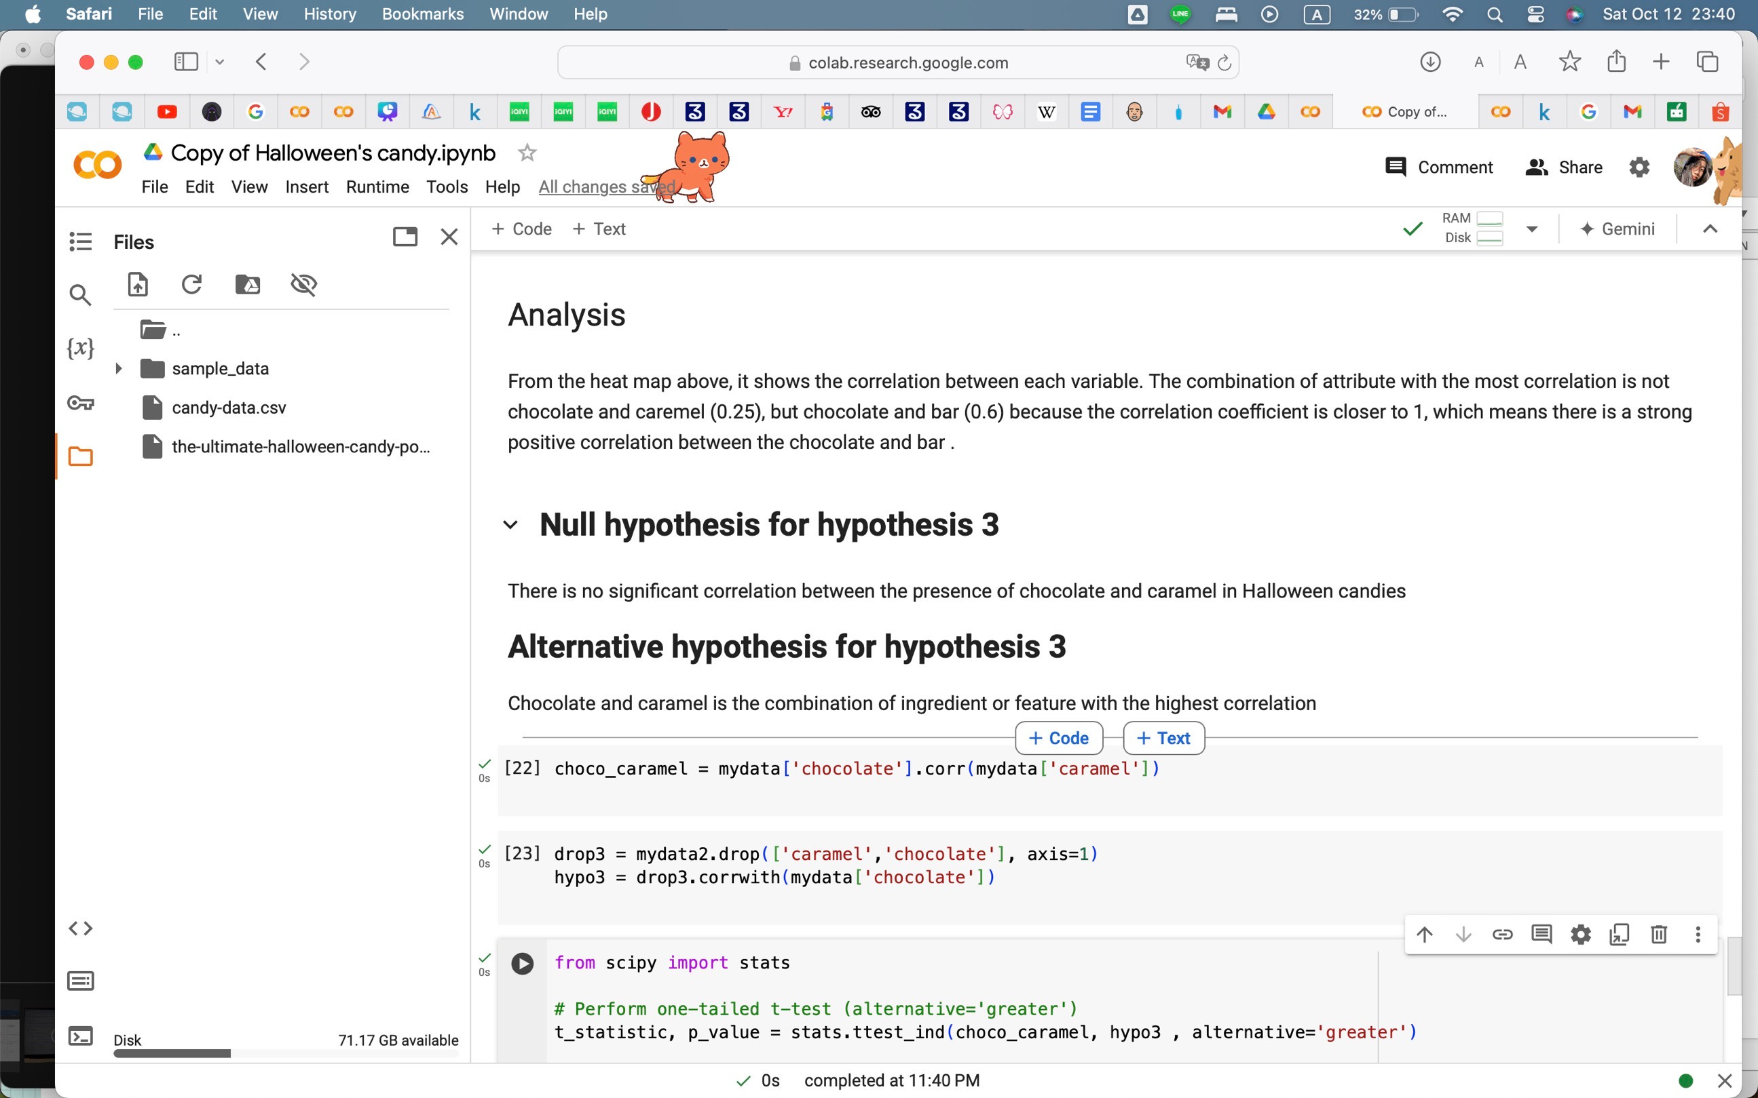

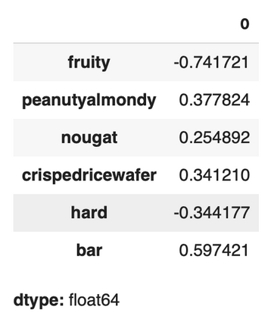

Hypothesis 3
rd
3 Step
Null hypothesis: There is no significant correlation between the presence of chocolate and caramel in Halloween candies
Alternative hypothesis: Chocolate and caramel is the combination of ingredient or feature with the highest correlation
The correlation value of chocolate and caramel
The correlation value of chocolate and other features

Slide 16

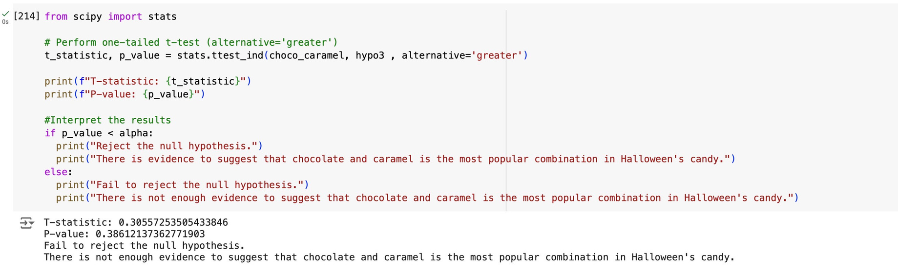
Hypothesis 3
One tailed
Fail to reject H0
-0.05
0
0.05
The output shows that it fails to reject the null hypothesis (P-value=0.38) which means that the data don’t show a strong enough correlation, indicating the combination of chocolate and caramel may not be the ingredient or feature with the highest correlation

Slide 17
Conclusion
From our three hypotheses, after we use T-test to prove, we can conclude that:
First hypothesis - Reese’s peanut buttercup is the most popular candy during halloween was proven to be True
Second hypothesis - chocolate is the most often used ingredient/feature in Halloween candy was proven to be false ( fruity is the most used)
third hypothesis - chocolate and caramel is the combination of ingredient or feature with the highest correlation was proven to be false ( Chocolate and bar have the highest correlation)

Slide 18



Citation
dataset
APA citation
The Ultimate Halloween Candy Power ranking. (2017, October 31). Kaggle. https://www.kaggle.com/datasets/fivethirtyeight/the-ultimate-halloween-candy-power-ranking

